Slide 1
What You
Need to Know
About the Financial Aid Process
2018-2019
Faith Phillips
Director, Financial Aid
Central Ohio Technical College & Ohio State Newark

Slide 2


Before we get started
Ask Questions tonight or contact me later
Federal Aid is based on Federal Laws
DO NOT PAY to file the Free Application for Federal Student Aid or for scholarship searches.
  Completion and processing of the FAFSA are FREE
  If filing via FAFSA on the Web, be sure to go directly to www.fafsa.gov

Slide 3

What is FAFSA and Financial Aid?
FAFSA = Standard Form that collects information about the student and parent
Financial Aid = Funds provided to students to help pay for educational expenses. This is achieved by:
  Evaluating family’s ability to pay
  Distributing limited resources in equitable manner
  Providing a balance of gift aid and self-help aid

Slide 4

FAFSA
May be filed at any time during an academic year, but no earlier than October 1st prior to the academic year for which the student requests aid
For the 2018–19 academic year, the FAFSA may be filed beginning October 1, 2017
Most colleges set FAFSA filing deadlines
Must Re-apply for aid every year starting October

Slide 5

FAFSA: WHY file and WHY on-line?
WHY File the FAFSA?
  Don’t assume you won’t be grant eligible
  Schools may have institutional funds that require the FAFSA
  Circumstances can change quickly
WHY use FOTW?
  FASTER processing with built in HELP
  Edits built in to prevent errors
  Skip Logic to answer only questions that pertain to you
  IRS Data Retrieval Tool
  Simplified process in future years

Slide 6

What is Expected Family Contribution (EFC)?
The FAFSA Calculates the (EFC) Expected Family Contribution
  Amount student/family can reasonably be expected to contribute toward the student’s education for an academic year (NOT what you owe the college)
  Stays the same regardless of college
  Calculated using a Federal Formula
    Parent and student contribution
  Used by Colleges to award financial aid

Slide 7
Sources of Financial Aid
Federal government (largest Source)
  Primarily based on financial NEED
  Must file the FAFSA
State of Ohio
Colleges and universities
Private sources

Slide 8
Colleges and Universities
Award aid on the basis of both merit and need
Aid may be gift aid or self-help aid
Use information from the FAFSA and/or institutional applications
Financial Aid Process connected to Admissions
Deadlines and application requirements vary by institution (Check with each college or university)
School Issued email and access to school portal/self-service

Slide 9

Principles of Need Analysis (FAFSA Process)
Parents have primary responsibility to pay for their dependent children’s education
Students also have a responsibility to contribute to their educational costs
Families should be evaluated in their present financial condition (2016 Tax Information)

Slide 10

What IF… Unusual Circumstances
Examples of special circumstances
  Change in employment status
  Child support ends/ended
  Medical expenses not covered by insurance
  Change in parent marital status
  Unusual dependent care expenses
Cannot be documented on the FAFSA
Send written explanation and documentation to FA office of each college
College will review and determine if additional information is needed (school has final decision)

Slide 11
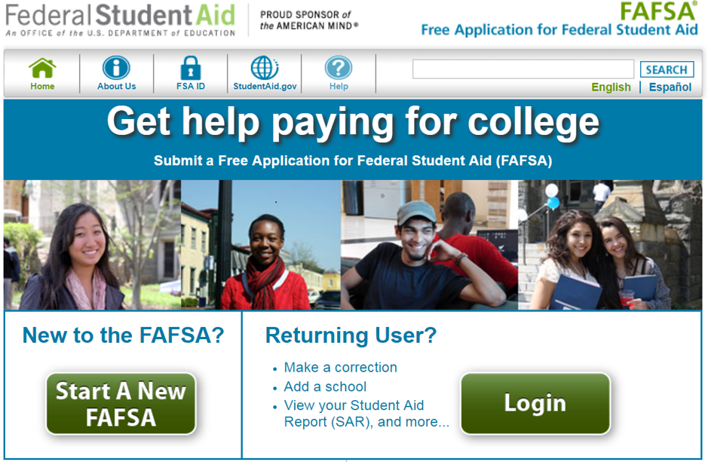
FAFSA on the Web (FOTW)

Slide 12
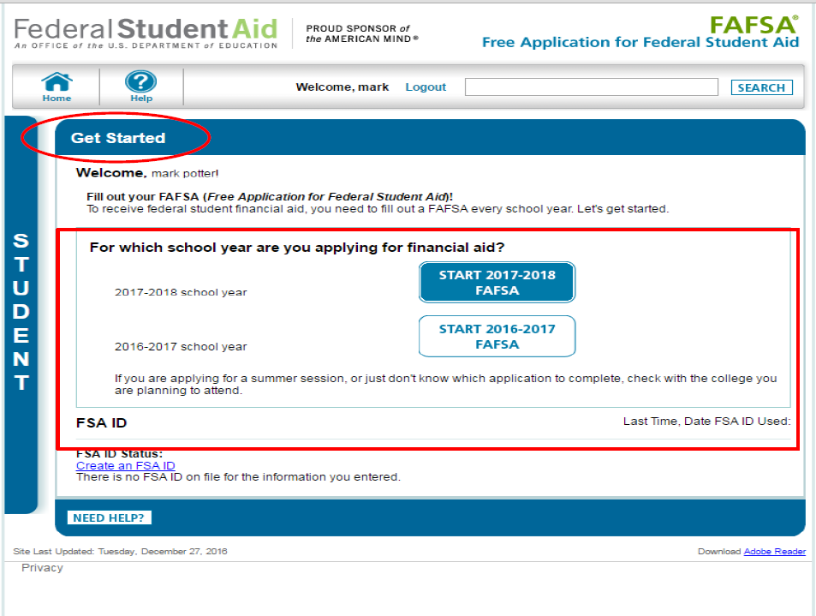
FAFSA on the Web (FOTW)
There will be 2 years displayed. Aid for autumn of 2018 select 2018-2019 which will display October 1, 2017.

Slide 13

Signatures
Required
  Student
  One parent (dependent students)
Format for submitting signatures
  Signature page
  Electronically using FSA ID

Slide 14
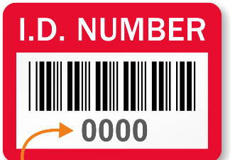
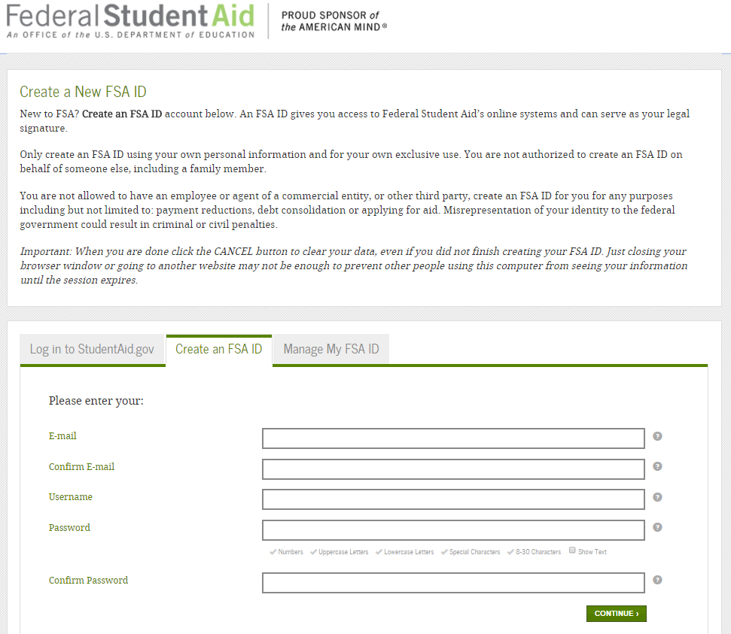
FSA ID
Sign FAFSA electronically
Not required, but speeds up processing
May be used by students and parents throughout aid process, including subsequent school year
Only the owner should create a FSA ID
https://fsaid.ed.gov/npas/index.htm

Slide 15
FSA ID Helpful Hints
Student and Parent MAY NOT use the same email address
Student and Parent MAY NOT use the same Cell Phone number.
Verify your email address is important. It allows you to use your email ad your username when logging into FAFSA.

Slide 16
FASFA collects: General Student Information
Social Security Number
Name
DOB
Address
Citizenship status
Marital status
Drug convictions
Selective Service registration

Slide 17

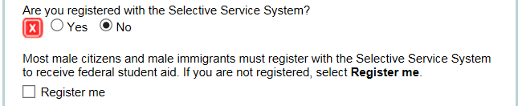
Selective Service Question
Males (18-25) are required to be registered with selective service for Federal Aid Eligibility
If 17 at submission
  Register on 18th Birthday OR
  Select REGISTER ME (will register student within 30 days of b-day)
If 18 at submission and NOT registered
  Select REGISTER ME OR
  Register at www.sss.gov
If 18 at submission and REGISTERED
  No action needed

Slide 18
Dependency Determination
Answer “NO” to all 13 questions, student is dependent and must provide parent information
Answer “YES” to any question, student is independent
  Example: Children/dependents, legal guardianship, foster care, orphan/ward of court, at risk for homelessness
Special Circumstances select “I am unable to provide parental information”

Slide 19
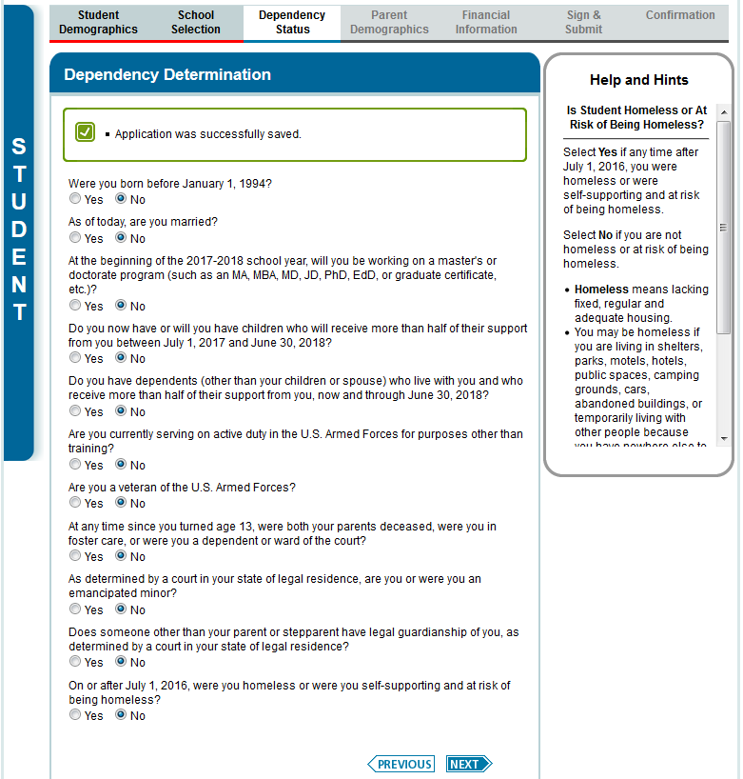
Dependency Determination

Slide 20
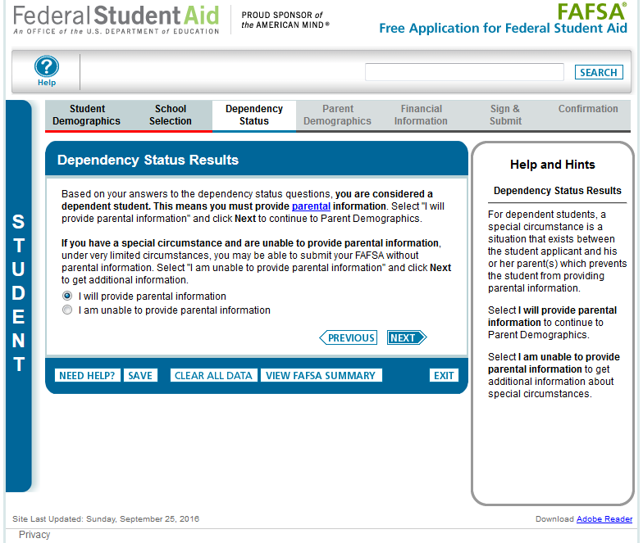
Dependency Determination

Slide 21
WHO is the Parent for the FAFSA?
Biological or Adoptive Parent(s)
  If not married BUT living together report BOTH parents
If parents are divorced:
  Provide information for the parent you lived with most during the last 12 months
  If you did not live with 1 parent more than the other, the parent who provided the most financial support during the last 12 months or most recent year you received support
Include Step-parent information
  Regardless of any ‘agreements’

Slide 22
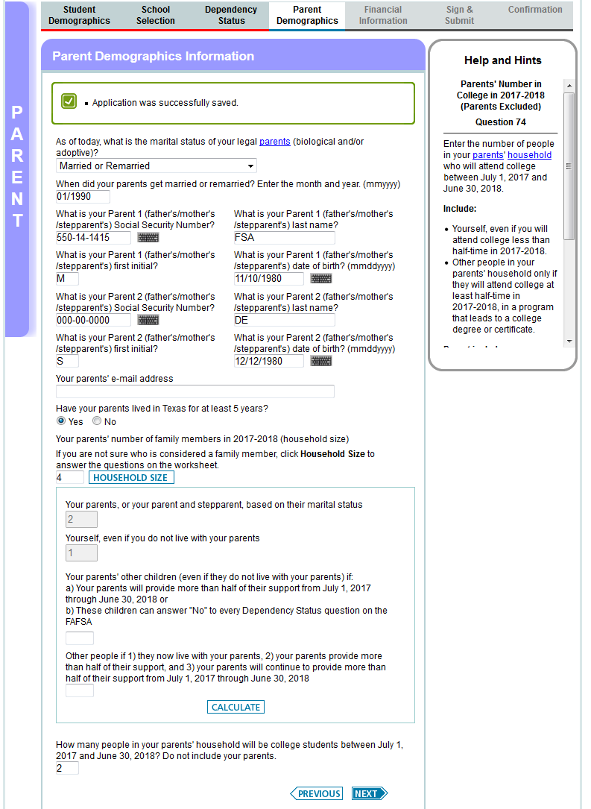
Parent information

Slide 23

Things to remember/prevent errors
Watch student vs. parent info
  YOU or YOUR parent
  Blue sidebar = Student
  Purple sidebar = Parent
Social Security Numbers/Names
  Must match social security card
Watch state of legal residence
Read income and assets questions carefully
  Use HELP features

Slide 24

IRS Data Retrieval Tool
While completing FOTW, applicant may submit real-time request to IRS for tax data
IRS will authenticate taxpayer’s identity
If match found, IRS sends real-time results to applicant in new browser window
Applicant chooses whether or not to transfer data to FOTW

Slide 25

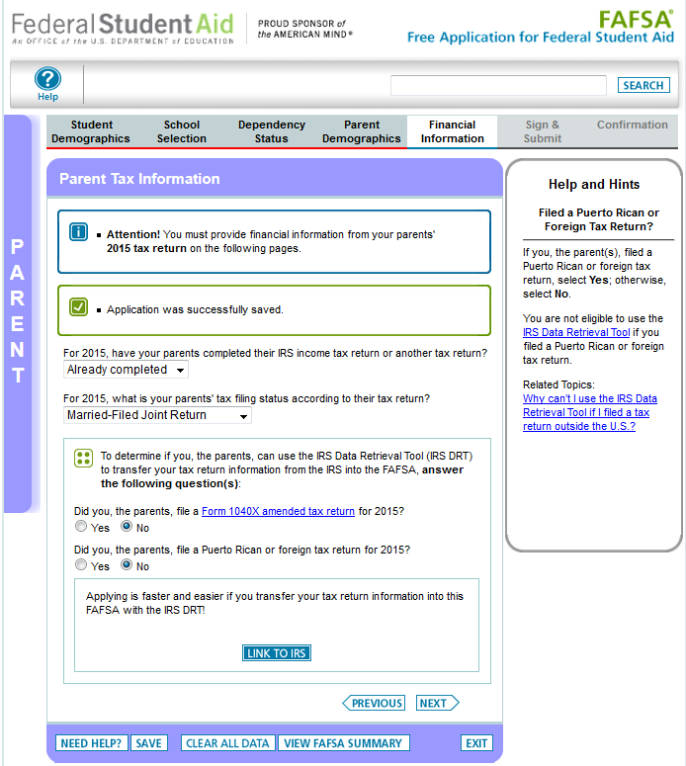
IRS Data Retrieval Tool

Slide 26
IRS Data Retrieval Tool
Some will be unable to use IRS DRT
Examples include:
  Filed an amended tax return
  Student or parent married, but filed separately/head of household

Slide 27
Net worth of investments (As of ‘today’)
Cash, Savings, and Checking
Investments/Business/Farm Value
  Current/market value minus debt = Net Worth
  Real estate (not home you live in), trust funds, UGMA and UTMA, money market and mutual funds, CD’s, stocks, bonds, commodities
  Education benefits/savings accounts (Coverdell, 529, refund value of prepaid tuition plans)
    Asset of the parent not student
    Must include value of ALL accounts owned by parent

Slide 28
Assets NOT included on the FAFSA
Home you live in
Value of Life Insurance
Traditional Retirement Plans
Cash, Savings, Checking already reported
Business or farm with 100 or fewer full-time or full-time equivalent employees
Family Farm you live on and operate
UGMA and UTMA accounts you are custodian not owner

Slide 29
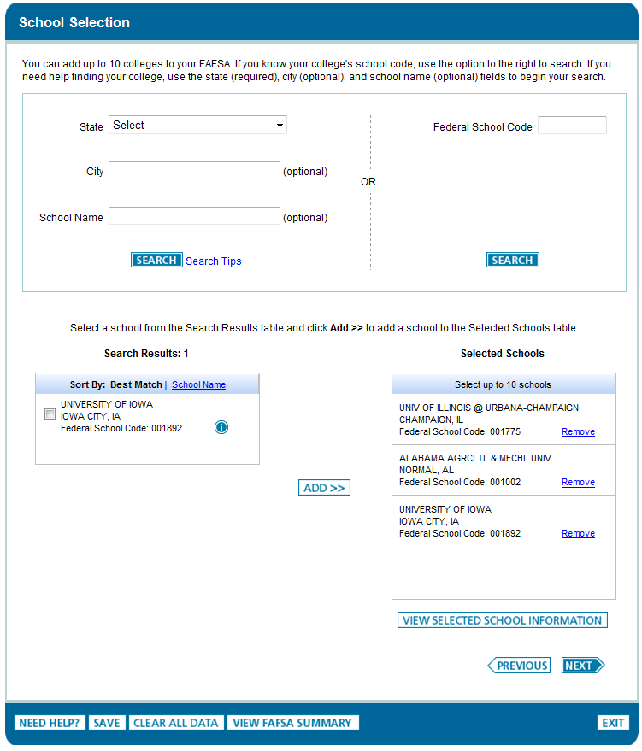
School Selection Step
Student may enter up to 10 colleges by entering Federal School Code or Searching on State, City or School Name
Notes:
The search functionality for colleges has not changed from last year. The applicant may enter up to 10 school codes or may search by state, city or school name.

Slide 30
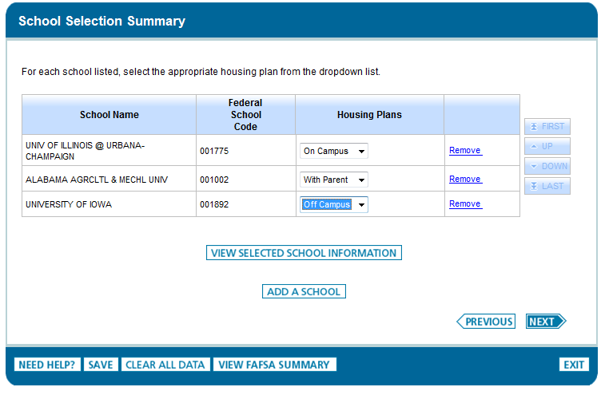
School Selection Setup (continued)
View Selection School Information allows you to compare each school tuition and fee information

Slide 31

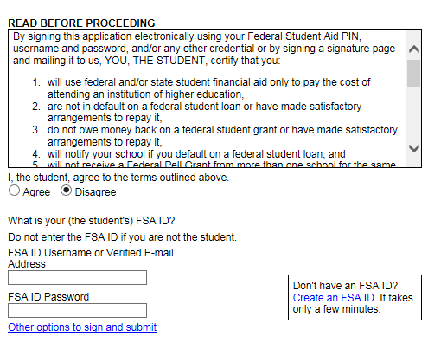

Sign with FSA ID (parent and student)
Other options to sign and submit
Print signature page OR
Submit without signatures
“View or Print your FAFSA information
Notes:
If the applicant selects to Print A Signature Page the Print Signature Page button dynamically appears.

Slide 32

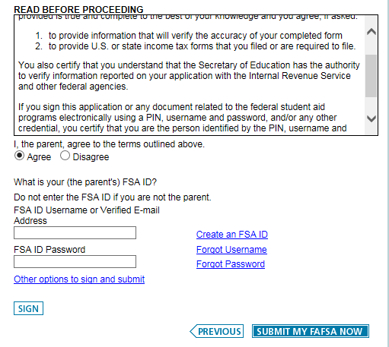
Do not forget to Submit
Notes:
If the applicant selects to Print A Signature Page the Print Signature Page button dynamically appears.

Slide 33
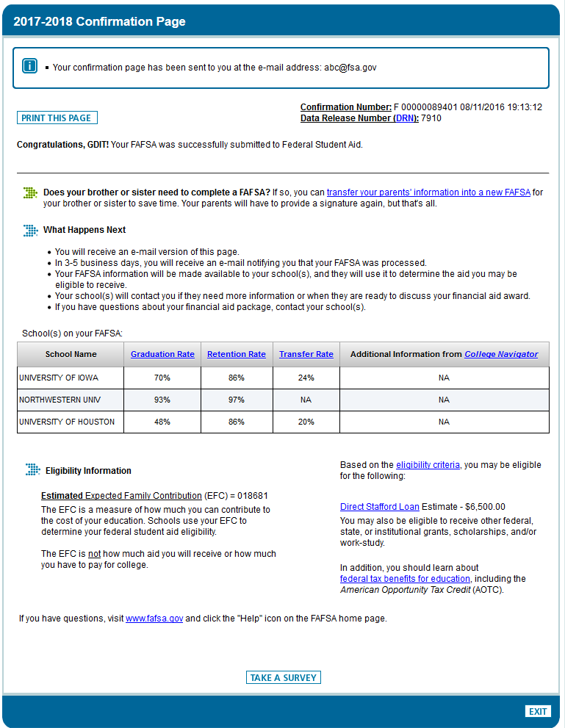
Confirmation
Page
Includes -
Confirmation Number
EFC estimate
Pell Grant and Direct Loan estimates
Option for parents to transfer info to an application for a sibling
Rates for each college on the FAFSA

Slide 34
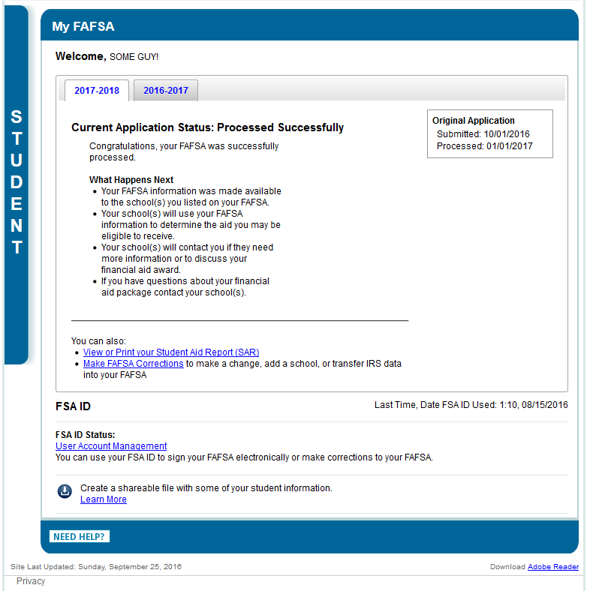
“Processing” when first submitted
@ 48 – 72 hours
You can print the Student Aid Report or Make Corrections.

Slide 35
Role of Financial Aid Office
  Reviews FAFSA information for accuracy
  Verification: may request additional information/documentation
    Income/tax data (IRS Tax Transcript)
    Household Size/Number in College
    High School Completion/Identify and Statement of Educational Purpose
  Determine eligibility for financial aid
    Sends (usually by email) an Award Notification which includes:
      Amount of student’s financial need
      Aid awarded from which programs
      How and when aid will be disbursed
      Terms and conditions of student’s award
Notes:
20

Slide 36
Federal Pell Grant
Federal Grant that does not have to be repaid
Awarded to the neediest students
If eligible, will see estimated award on the confirmation page.
Maximum award amount for 2017-2018
  $5920
Maximum EFC for Pell Eligibility
  5328

Slide 37
Student Loans
Federal Direct Student Loans
  Students name only
  Borrowed directly from the Federal Government
  Subsidized: based on need/interest paid while in school
  Unsubsidized: not based on need/interest accrues
  Maximum Freshman eligibility = $5500/year
  No payments until 6 months after graduation
  Interest Rate variable
    Rate 7/1/16 – 6/30/17 = 3.76%

Slide 38
Parent Loans
Federal Direct Parent Loan (PLUS)
  Parent’s name only
  Borrowed directly from the Federal Government
  Requires a credit check
  Maximum amount = Cost minus other aid
  Option to defer payment while student is enrolled
  Interest rate variable
    Rate 7/1/16 – 6/30/17 = 6.31%

Slide 39

Private Sources
Companies may have scholarships available to the children of employees
Companies may have educational benefits for their employees
Foundations, businesses, charitable organizations
Deadlines and application procedures vary widely
Begin researching private aid sources early
Research what is available in community
To what organizations and churches do student and family belong?
Application process usually occurs during spring of senior year
Small scholarships add up!

Slide 40
Scholarship Searches
FastWeb
  www.fastweb.com
College Board FUND FINDER
  www.collegeboard.org
Scholarships.com
  www.scholarships.com
For additional reputable sites go to:
  www.FINAID.org

Slide 41
Contact Information
Faith Phillips
Phillips.495@osu.edu
740-366-9492

Slide 42




QUESTIONS???

